Slide 1

Anomaly Detection System
By Data Analyst interns

Slide 2






Outline
Introduction
Target Population
Anomaly detections
methods used
Content of the system
Benefits

Slide 3





Technologies used
Outline
How to control
How it works
Problems Encountered
Improvements

Slide 4

Introduction

Slide 5

Introduction
The main purpose of the anomaly detection is to identify cases that are unusual within the dataset that is seemingly comparable.
By exploring the anomalies, user can identify the abnormal patterns and the deviations from the regular style.
So, the goal of the implementing an anomaly detection system is to easily identify the anomalies of any given dataset.

Slide 6
Target Population

Slide 7


Target Population
Data Analysts
Data Enthusiasts
Data Engineers
Companies that work with data

Slide 8
Content of the System

Slide 9

Anomaly Detection Methods Used
Interquartile Range (IQR) method
Any values that fall outside from +/-(IQR*1.5)
Isolation Forest
It identifies anomalies using isolation.
Minimum Covariance Determinant method
A robust estimator of multivariate location
Local Outlier Factor
Identifying the outliers considering the density of neighbourhood
Support Vector Machine (SVM)
One-class SVM method is used to classify outliers.
KNN algorithm
It classifies outliers based on the neighbourhood of objects whose major attributes are not similar.

Slide 10
Benefits

Slide 11

Benefits
Can easily obtain a file with outliers of the uploaded data set using commonly used outlier detection methods
Can obtain the summary statics of the uploaded data set numerically and graphically
Less time consuming
User friendly interface
Knowledge sharing

Slide 12
How To Control

Slide 13
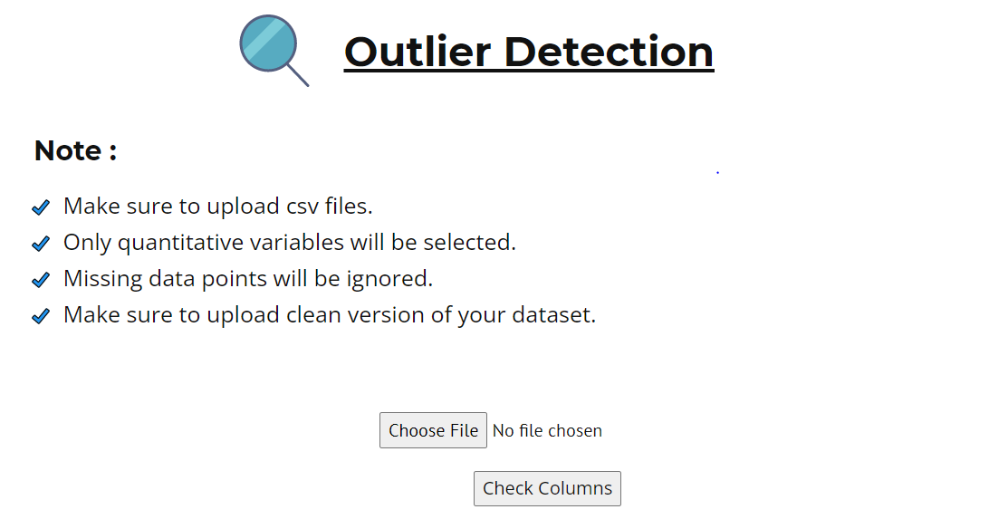

Home Page

Slide 14
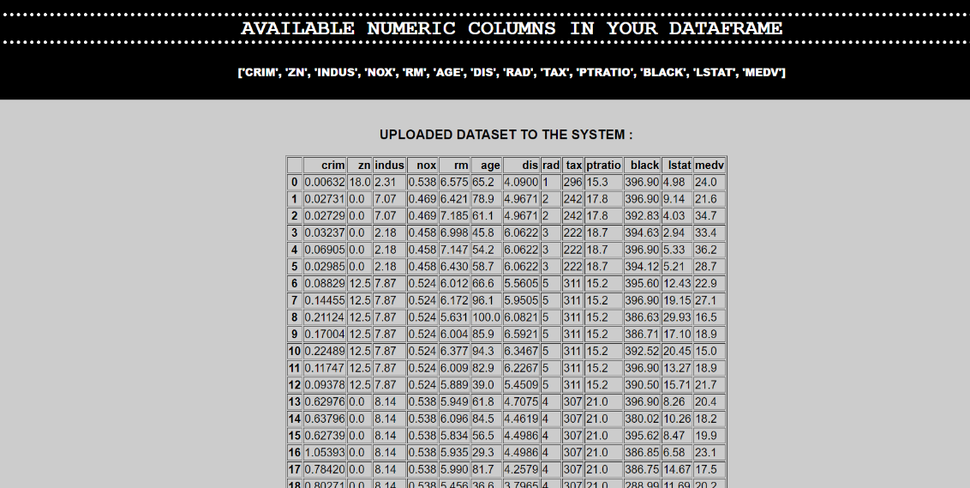

Displaying the column names of the numerical columns and the overview of the dataset

Slide 15
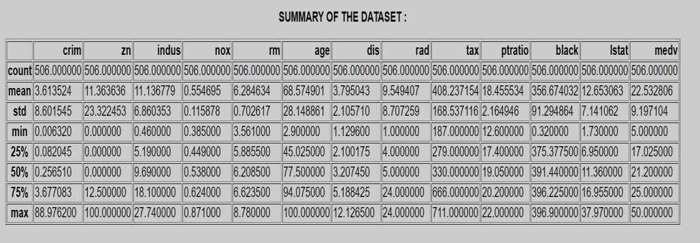

Displaying descriptive summaries of the dataset

Slide 16
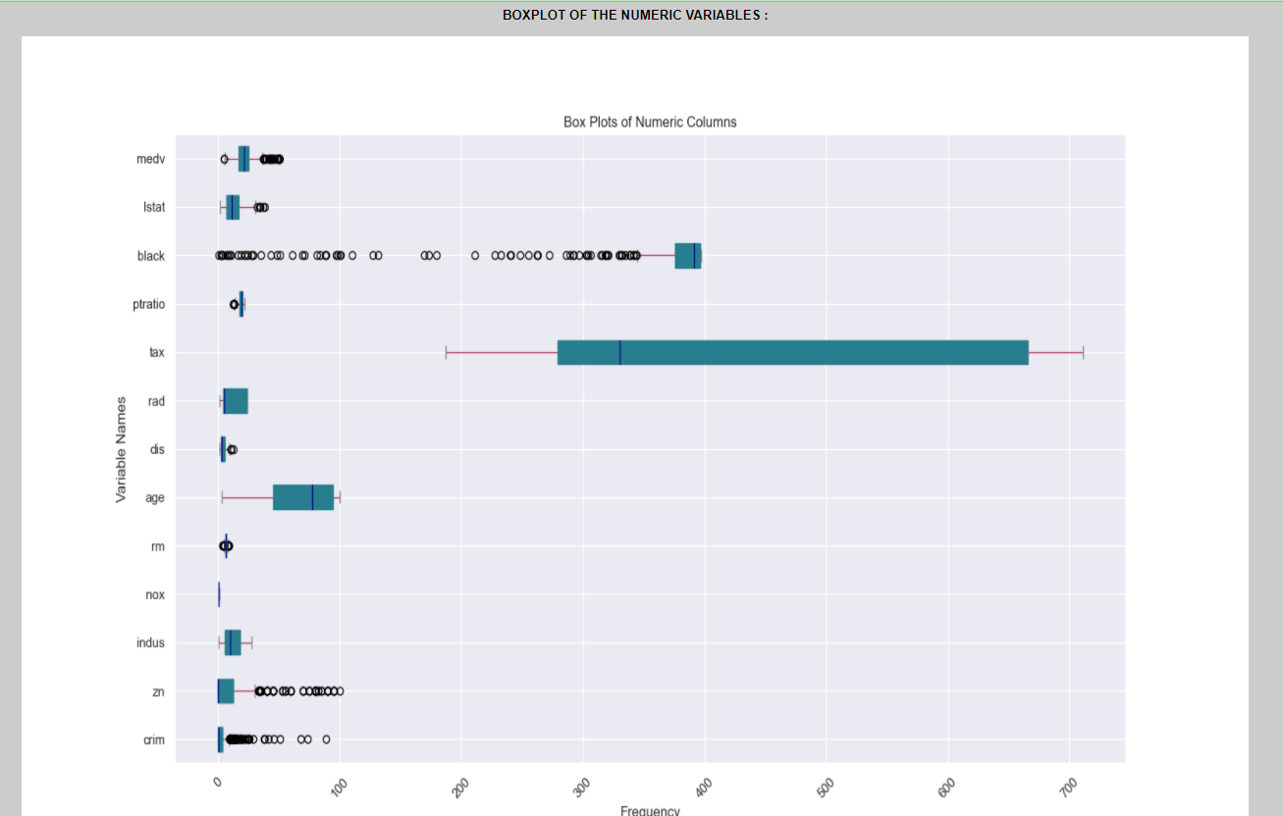

Displaying the boxplots of the numeric variables

Slide 17
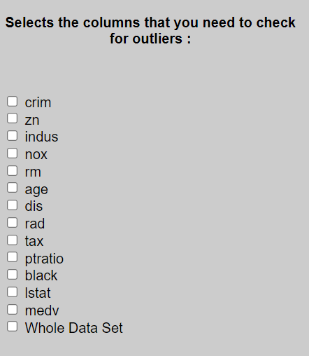
User can select the numerical columns according to the preference to check the outliers

Slide 18
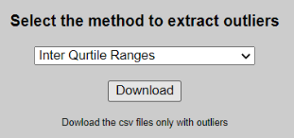
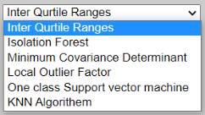

User can select one of the anomaly detection method from the drop down list and then click on the download button to download the csv file of the filtered anomalies

Slide 19
Technologies Used

Slide 20




Technologies Used
Python flask
HTML
Bootstrap CSS
JavaScript

Slide 21
How it Works

Slide 22


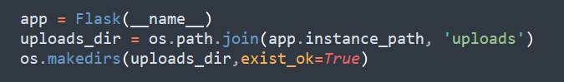
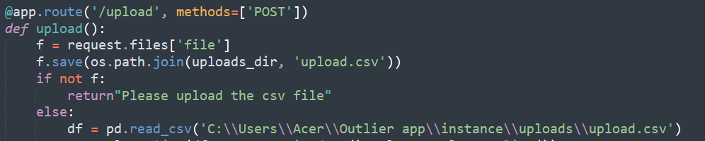
Step 01 : Uploading CSV File.

Slide 23
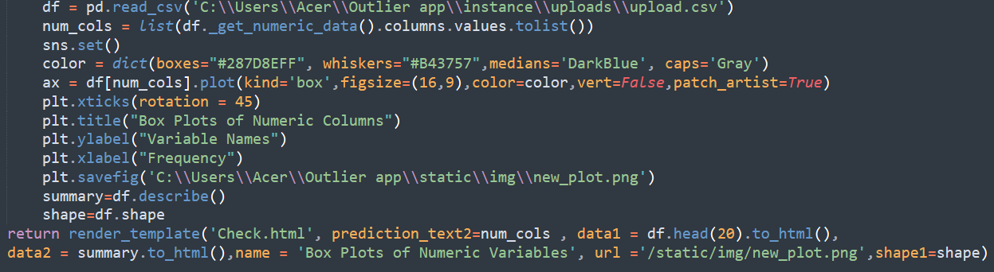
Step 02 : Visualizing the uploaded data set , Summary Statistics and numerically and Graphically.( App.py).

Slide 24
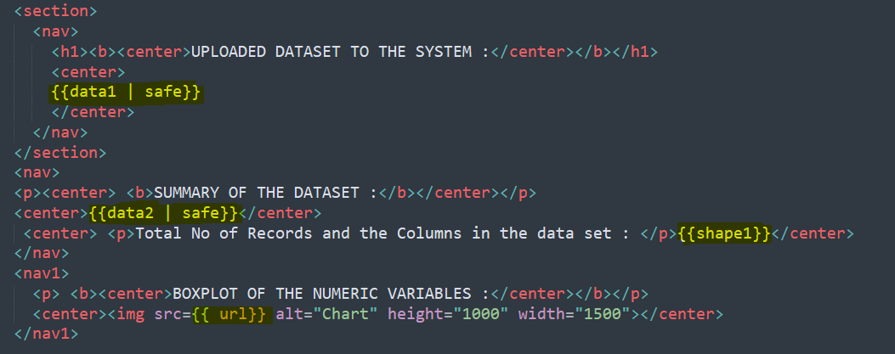
Step 02 : Visualizing the uploaded data set , Summary Statistics and numerically and Graphically.( HTML)

Slide 25
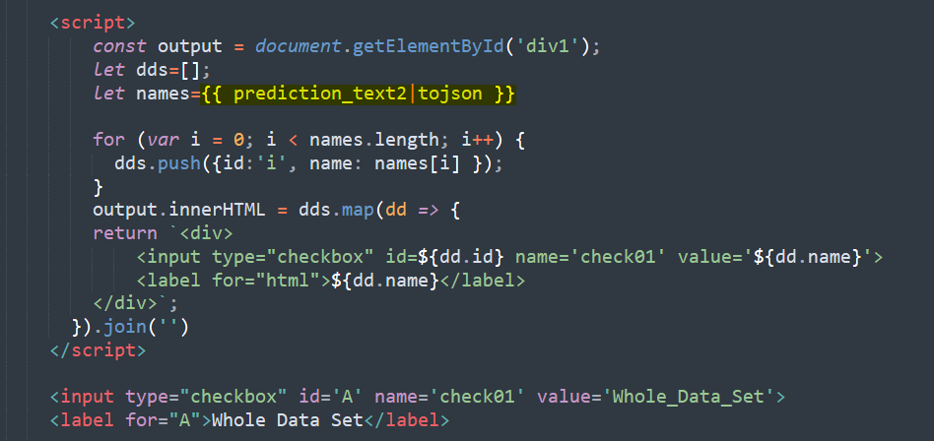
Step 03 : Displaying the Numerical Columns as Checkboxes

Slide 26
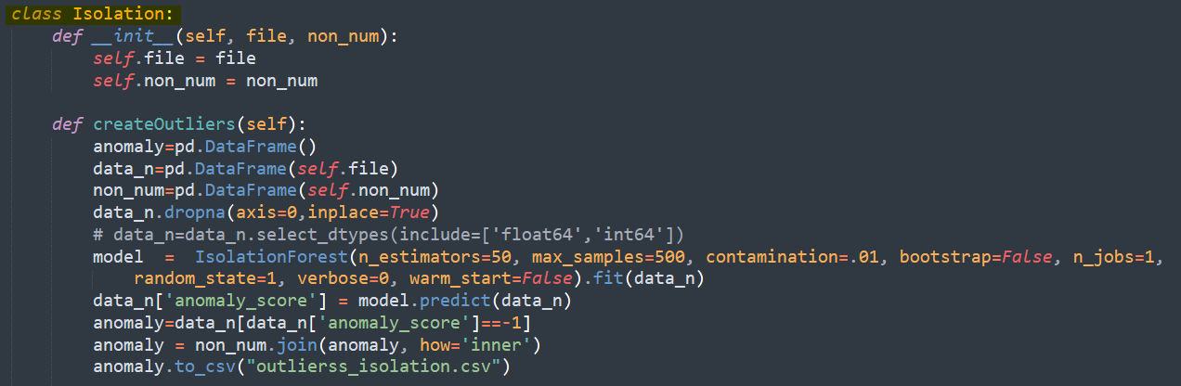
Step 04 : Define Classes for each outlier detection technique

Slide 27
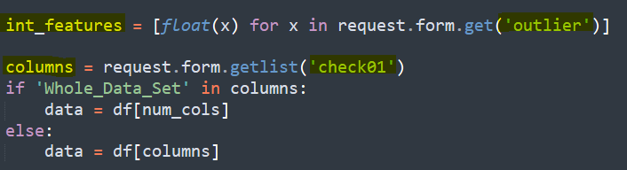
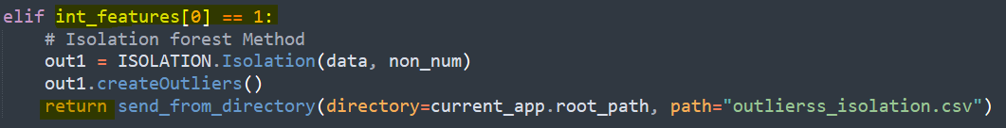
Step 05 : Pass the csv file with outliers to frontend

Slide 28
Problems Encountered

Slide 29
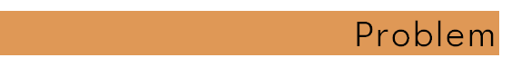


Problems Encountered
Displaying Numeric columns as Checkboxes
Java Script was used to display numeric Columns.
Code became complex when modifications applying
Classes were defined to reduce the complexity.
Required to upload the CSV file two times to detect the outliers
Uploaded data set was saved inside the system.

Slide 30
Suggestions & Improvements

Slide 31

Suggestions & Improvements
Except IQR method and Isolation Forest method, other anomaly detection methods take much time for the datasets which have the observations more than 150K.
Therefore, the system needs to be modified which would be efficient for larger datasets.

Slide 32


